Slide 1

House Rental
Services
By :
1602-19-737-127 Anurag Sahu
1602-19-737-167 B. Shailendhar
1602-19-737-317 B. Vikas

Slide 2
Problem Statement
Problem Statement
In Current System, customer requires to find rental homes manually or should visit House rental company or should approach a Real Estate agent, which is tiresome and wastes alot of time. In existing system customers aren't allowed to rent a house without physically contacting the house owner. The current system does not have a secure online payment method to pay rent. In the current system we don't get any details of house specifications unless we visit the home.

Slide 3
Problem Statement
Objective
Main Objective:
The main Objective of this project is to develop an online Rental Property website that allows users to rent a house without contacting a Rental Company or Estate agent.
Specific Objectives:
To analyze the manual system for managing rental houses, outline it’s flaws and provide better solutions.
To study and analyze requirement specifications of online House Rental Services that allows successful rental of a house.

Slide 4
Problem Statement
Abstract
The project purpose is to search rental homes online. This web application helps users to search rental homes in desired location based on their requirements and house specifications.
The application provides complete information about available rental homes with details of rent cost, address, BHK, availability of vehicle parking, floor, facing, area, status and nearby landmarks. The application has a special feature, where users can interact with the existing members of their society through chat. For every society, a separate blog will be available where the user can get information related to things currently happening in the society. A user can post issues related to the rental home directly to the owner using this application.
With this application, a normal user can search for rental homes and a registered user can have access to contact house owner. Property owner can be able to post details of his rental property. Using this site, users can also book visit for a site visit.
This Application is one of the best opportunities for those who cannot enough time in searching rental homes manually. This application helps customers in filtering rental homes based on their budget, house specifications, facing, locality and availability of vehicle parking.

Slide 5



Problem Statement
Actors
User
Owner
Admin

Slide 6
Problem Statement
Use Cases
User
Owner
Admin
Register
Login
View rental homes
Pay rent
Rental Agreement
Search by Budget
Book for site visit
Shortlist
Complain an Issue
chat with neighbours
Register
Login
Post Property Details
Edit property details
Delete property
Payments
Chat with User
Login
Add/Edit/Delete property details
Property verification

Slide 7
Problem Statement
Tech Stack
Frontend :
HTML
CSS
Bootstrap
JavaScript
Backend :
Python
SQLite DB
Framework :
Django

Slide 8
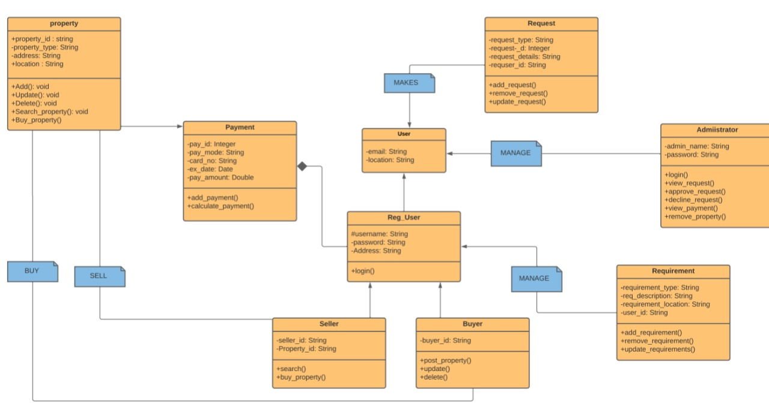
Problem Statement
CLASS DIAGRAM

Slide 9
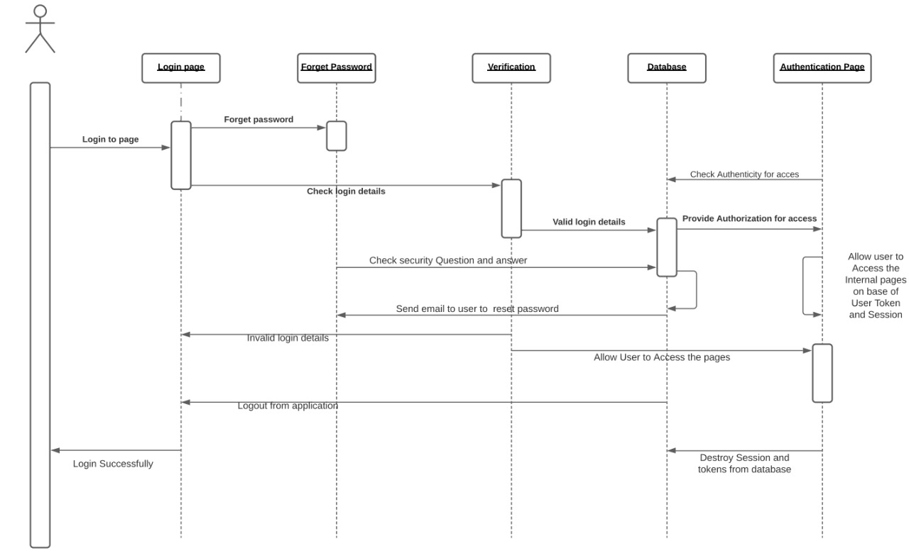
Problem Statement
SEQUENCE DIAGRAM

Slide 10
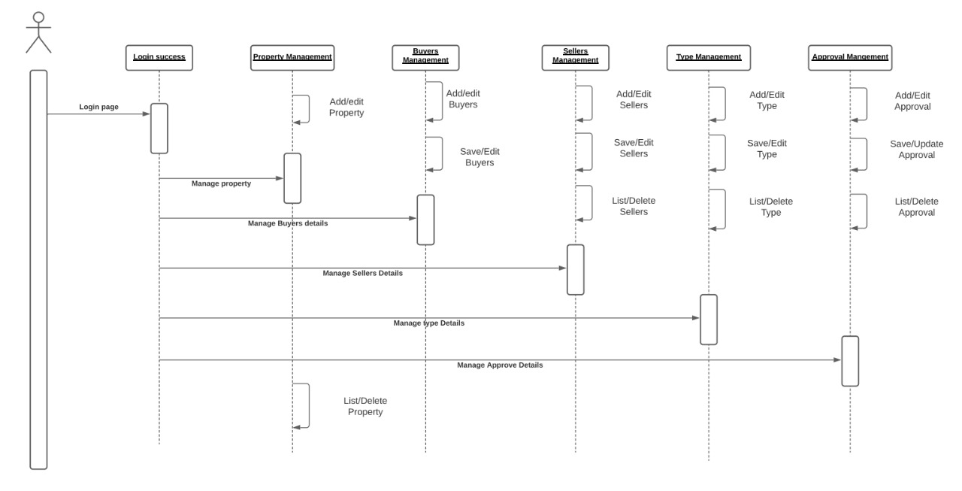
Problem Statement
SEQUENCE DIAGRAM

Slide 11
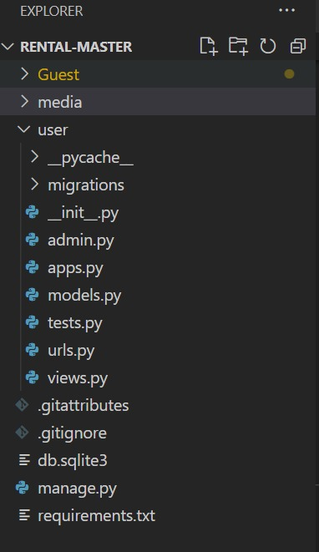
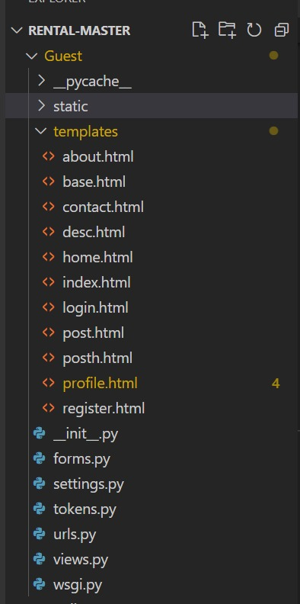
Problem Statement
DIRECTORY STRUCTURE

Slide 12
IMPLEMENTATION

Slide 13
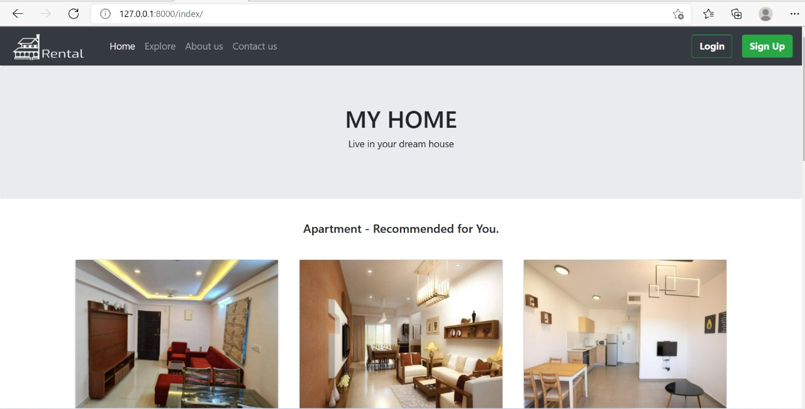
HOME PAGE

Slide 14
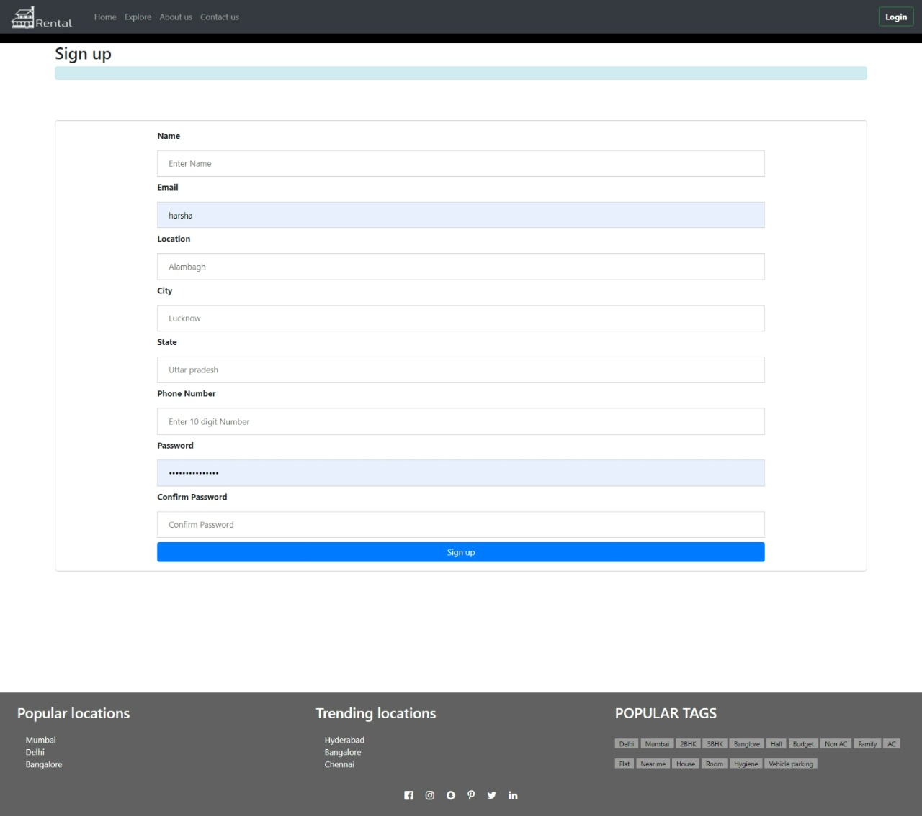
SIGN UP

Slide 15
SIGN UP

Slide 16
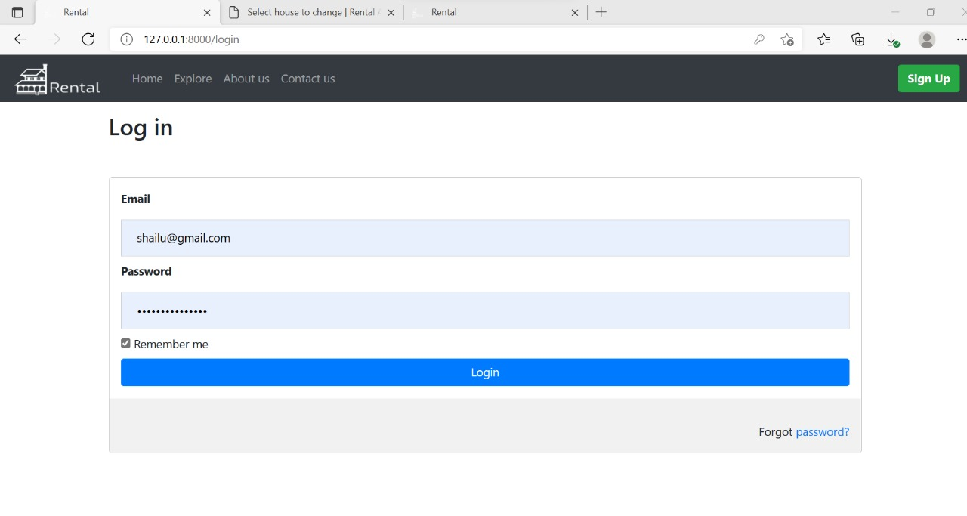
LOGIN

Slide 17
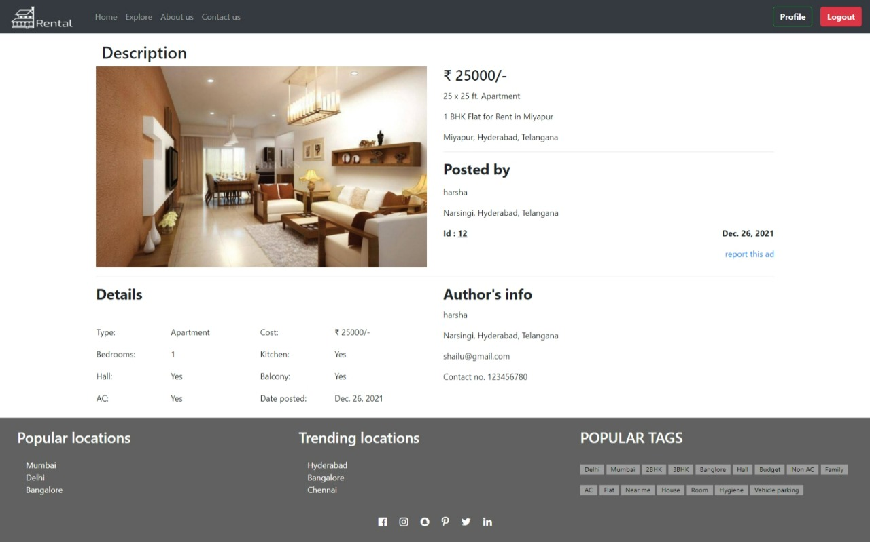
DESCRIPTION

Slide 18
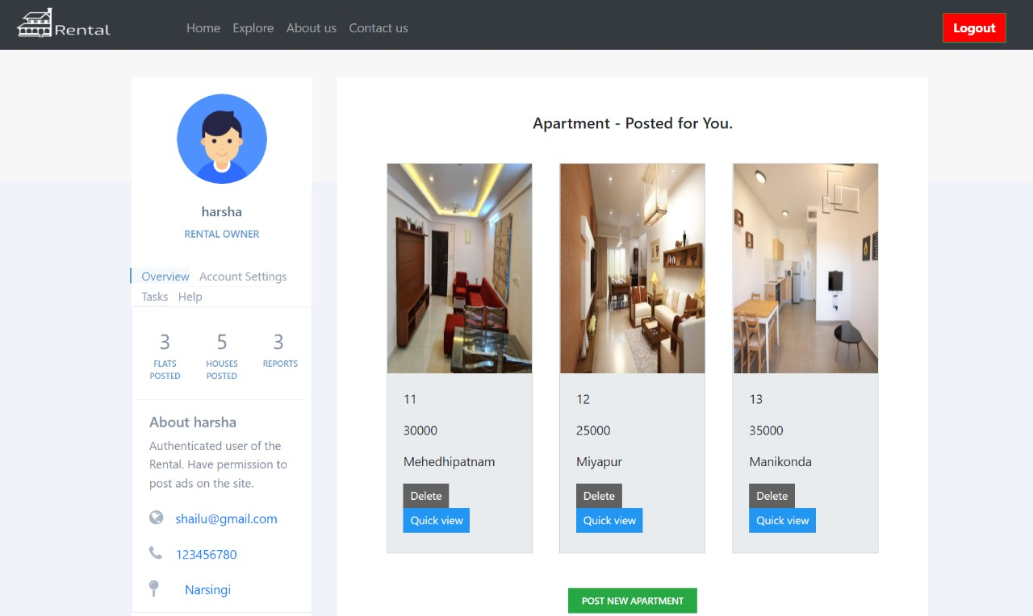
PROFILE

Slide 19
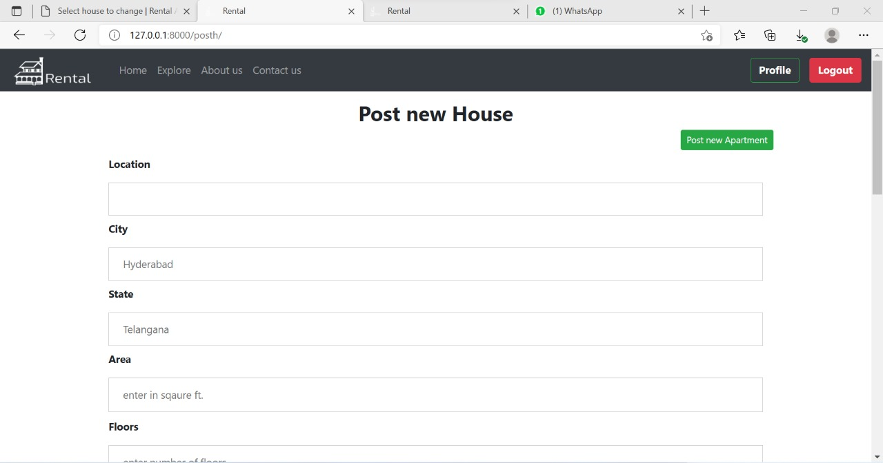
POST NEW HOUSE

Slide 20
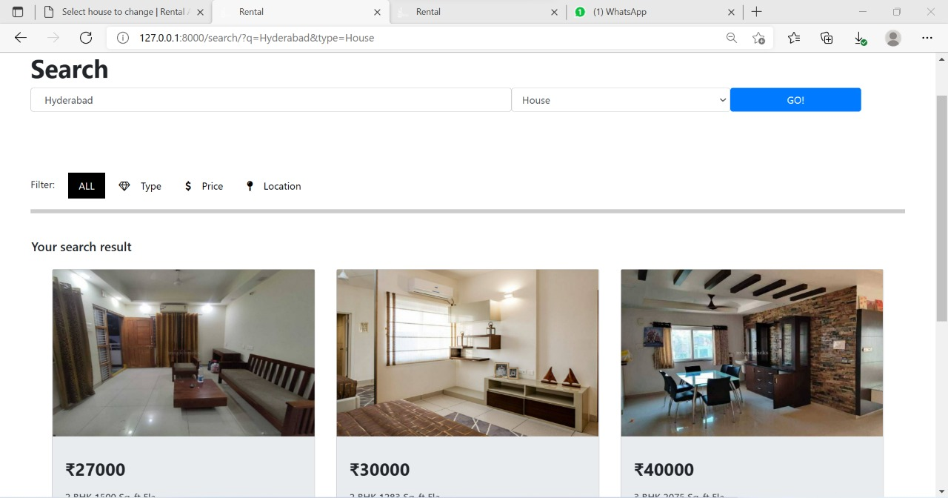
SEARCH BY PLACE

Slide 21
Problem Statement
CONCLUSION
We have successfully developed a secure, user-friendly web application. This system is capable of searching properties, posting ads of properties for rent and sale.It uses a client/server architecture based on the HTTP protocol. It is developed in Microsoft’s Visual Studio. The buyer performs a search for the property listings by putting either City/State in the search textbox. The business logic tier communicates with the database tier requesting the results of the query sent by it. The results obtained by the database are displayed on the data grid, by refreshing the grid rather than refreshing the entire web page. This system will definitely reduce the time to search for a house to have it for rent or to buy by having all the properties online.

Slide 22
Problem Statement
REFERENCES
https://youtube/cdPcTuazI/
https://youtube/1BeZxMbSZNI/ https://stackoverflow.com/questions/57217823/dj https://fontawesome.com/v4.7/icon/star-half-o https://docs.djangoproject.com/en/3.2/ref/models/querysets/ https://www.webforefront.com/django/usebuiltinjinjastatements.html

Slide 23
Thank You…

